Slide 1


Integrating data management planning into the pre-award, in award and post-award stages
Joy Davidson
Digital Curation Centre

Slide 2
About this course
Introduction to Research Data Management Landscape and to Data Management Planning
Overview of DMPonline tool and issues to consider during pre-award, in-award, and post-award phases of the grant lifecycle
Time for questions
Notes:
Intro – Associate Director, DCC. The DCC is a Jisc funded support service to help build research data management capacity in UK HEIs.
This session will introduce participants from the research office to data management planning at the pre-award, in-award and post-award phases and consider some of the sign-posting and general advice that research office staff may need provide to researchers. We’ll explore what other support services in the university need to be joined up to assist researchers in completing a data management plans.
The session will illustrate the data management planning process using the DCC’s DMP Online tool. This free wb-based tool allows researchers to complete, store and export data management plans.

Slide 3
Data Management Planning
Research Data Management Landscape
Data Management Planning

Slide 4

“Data sets are becoming the new instruments of science”
Dan Atkins, University of Michigan
Notes:
Why do we need to worry about research data management and sharing?
Data driven research is becoming the norm for all disciplines – not just science and technology.
For high quality, data driven research we will need access to high quality and understandable data.

Slide 5

Funders’ expectations of public access
“Publicly funded research data are a public good, produced in the public interest, which should be made openly available with as few restrictions as possible in a timely and responsible manner that does not harm intellectual property.”
RCUK Common Principles on Data Policy
http://www.rcuk.ac.uk/research/Pages/DataPolicy.aspx
Notes:
Research Councils UK Common Principles on Research Data Policy spells out their belief that publicly funded research outputs should be openly available.
Key to remembers – RCUK do not expect ALL data to be openly shared. RCUK expect researchers to share responsibly in light of data protection and IPR.

Slide 6
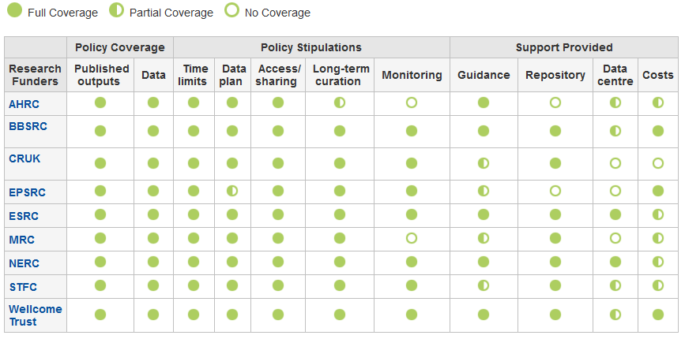
Research funder data policies
www.dcc.ac.uk/resources/policy-and-legal/ overview-funders-data-policies
Notes:
Researchers will need to determine whether their funder requires a data management plan at the grant application stage. This table provides a quick, at-a-glance overview of what is required by individual funders. By clicking on an individual funder in the table, you will be show more details on what that funder expects with regards to submission of a data management plan, any time limits on making data available, how long data must be retained following the end of the project, whether the funder has a support data centre for deposit and whether the funder will allow funds to be requested to cover data management and sharing activity within the life of the project. The DCC monitors and updates funders’ policy details frequently.
As you can see, all RCUK funders have polices relating to the management and sharing of research data and the majority of funders require researchers to submit a data management plan at the grant application stage.
EPSRC does not currently require a data management plan to be submitted with proposals but they expect that one will exist locally.

Slide 7

Ultimately funders expect:
timely release of data
once patents are filed or on (acceptance for) publication
open data sharing
minimal or no restrictions if possible
preservation of data
typically 5-10+ years if of long-term value
See the RCUK Common Principles on Data Policy:
www.rcuk.ac.uk/research/Pages/DataPolicy.aspx
Notes:
While the specific wording of RC’s policies differ, they essentially all want the same basic things.
Timely release – embargoes are usually allowed and time for patents to be filed will be respected. Usually 2 years is the maximum embargo period allowed.
Openness – remember though that this is in the context of being ‘responsible’. So, it does not mean everything! Funders are keen to have an idea of what will be shared through the work they fund.
Retention – funders recognise that impact takes a while to be realised. Therefore, they want some guarantee that the research outputs will not disappear. Remember, funding bodies have to demonstrate impact too – if they can’t, research funding budgets get cut.

Slide 8

“Research organisations will ensure that effective data curation is provided throughout the full data lifecycle, with ‘data curation’ and ‘data lifecycle’ being as defined by the Digital Curation Centre. The full range of responsibilities associated with data curation over the data lifecycle will be clearly allocated...”
...institutional responsibility
www.epsrc.ac.uk/about/standards/researchdata/Pages/expectations.aspx
Notes:
Most RCUK funders put the onus on the researcher to demonstrate that they had considered research data management and sharing issues. The Engineering and Physical Sciences Research Council (EPSRC) took a different approach and have instead put the onus on the HEI instead. They issued a set of nine expectations for HEIs seeking to secure funding from EPSRC and the compliance deadline came into effect on may 1st 2015. Recently, senior management at HEIs were sent a light touch qeustionnaire to assess progress towards compliance.

Slide 9
Data Management Planning
Planning to Share
Data Management Planning
Notes:
It is good to think about a data management plan as a plan for sharing – both with project partners in the in-project phase and more broadly in the post-award phase.

Slide 10

Benefits related to sharing data
Avoids duplication
Scientific integrity
More collaboration
Increased citation
(Piwowar H. and Vision T.J 2013 , https://peerj.com/preprints/1.pdf)
Notes:
We looked a bit at the drivers for data sharing earlier but it is important to stress the potential benefits to be realised as well.
Duplication – some funders want evidence in applications that researchers are not re-collecting data that already exists. At a minimum, it is a good idea to at check and funder sponsored data centre to see if the research proposed has already been carried out. If so, the researcher will need to justify why the data needs to be collected again (quality, scope etc).
Integrity – RDM is just part of good research practice. Worrying statistics recently about the low number of published research that is reproducable. Most HEIs keen to improve research integrity.
Collaborative opportunities – by making research outputs more visible and understandable to those outside their discipline, researchers may find that they are invited into more interdisciplinary proposals. HEIs and funders very keen on interdisciplinarity.
More citations – recent studies have revealed anywhere between a 9-30% increase in citations for those who make their data available along with their publications. As seen in the recent REF, this is always a good thing for researchers’ status and that of the HEIs who employ them

Slide 11
Who else is involved in data sharing?
PI/researcher – yes, but also…
research participants
commercial partners
the data repository
support staff
the secondary data user
Notes:
First, what do we mean by data sharing? We are making data available to researchers for scholarly work.
While the researchers themselves will have a key role to play in sharing data, it is important to note that they are not the only stakeholders involved in the process.
Research participants – informed consent is required (come back to this later)
Commercial – identify what can and can’t be shared and make this explicit.
Repository – how will data be made visible?
Support staff – e.g., Library staff to help describe data to make it easier to find and understand.
Secondary user – when sharing data, researchers can ask reusers to tick that they accept terms and conditions regarding fair use

Slide 12
Managing restrictions on sharing
Ethics
Informed consent – cover current and future use
Confidentiality – is anonymisation appropriate?
Access control – who, what, when?
IPR
Clarify copyright before research starts
Consider licensing options e.g. Creative Commons
Notes:
When dealing with sensitive data, there will need to be a balance between data protection with data sharing.
Best to make early contact with ethics team for advice and guidance. Often, institutional workflows mean that researchers only speak to ethics advisors when a grant has been awarded. This could be a risk as there may be a failure to reflect the aims for data sharing as outlined in the proposal once the award ahs been made.
In terms of costing, a delay in understanding what can and can’t be shared may mean that the grant application does not reflect the costs associated with data sharing. E.g., a small award of £10K where research participants will be interviewed and the interviews will be video-taped. Unless there is informed consent, it may mean that the video data cannot be shared without expensive anonymisation. In many cases, this can cost more than the original grant is worth. Best to decide early what participants will sign up to and to look for more cost effective alternatives (e.g., video data won’t be shared but anonymised transcripts will be).
Who will have access and when – timing is important. Decide who will have access and how during the life of the project. Will any security measures need to be in place for sharing between partners?
For projects involving commercial partners, much of the information requested in the data management plan may be covered in industrial agreements that are drawn up either at the pre-award or in-award phases. There may be potential to reuse the information provided in the data management plan for the industrial agreement and vice versa.

Slide 13




Use appropriate repositories - institutional
http://datashare.is.ed.ac.uk
Research Data at Essex and
DataPool at Southampton
www.dspace.cam.ac.uk
https://databank.ora.ox.ac.uk
Notes:
Not just looking for an indication that data will be shared in grant applications, funders want details on how it will be shared and made visible.
Several HEIs are developing new data repositories and/or extending their publications repository to cover research data. Please note though that these are not intended to replace national, subject or other established data repositories. Many HEIs choosing to accept data ONLY IF there is no other suitable place of deposit. I.e., a place of last resort.
13

Slide 14








Use appropriate repositories - external
Research funders’ data centres
Structured databases
Community initiatives
https://zenodo.org
http://figshare.com
http://www.re3data.org
Notes:
Many funders support data centres and will expect that the data is deposited at the end of the project. In these cases, the researchers just need to be sure to register this with the university so that a link between the published output(s) and the underlying data are recorded to comply with the RCUK OA policy.
If there is no funder-specific data centre, there may be other places of deposit available.
Zenodo – If you have no access to an OpenAIRE compliant repository, an institutional repository or a subject repository, Zenodo, hosted by CERN, will enable you to deposit your article and/or research data. Zenodo exposes its data to OpenAIRE, helping researchers to comply with the Open Access demands from the EC and the ERCs.
Figshare - figshare is a repository where users can make all of their research outputs available in a citable, shareable anddiscoverable manner.

Slide 15
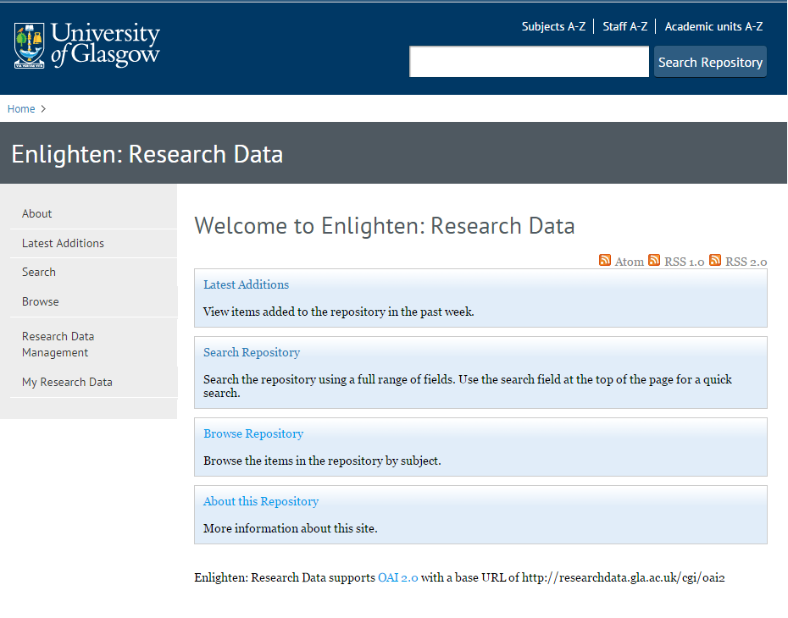
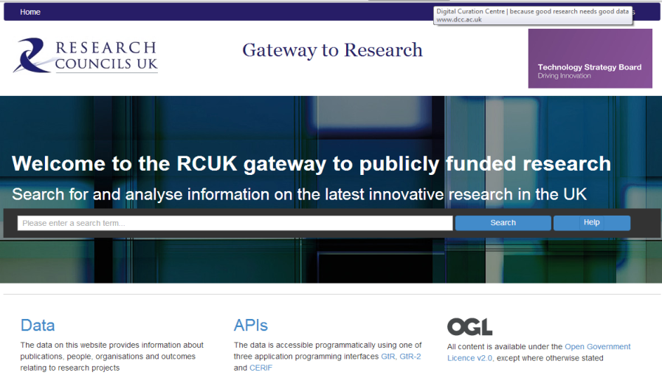
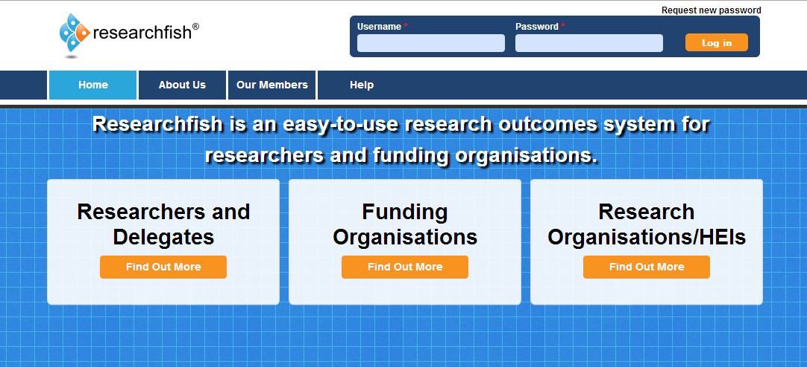
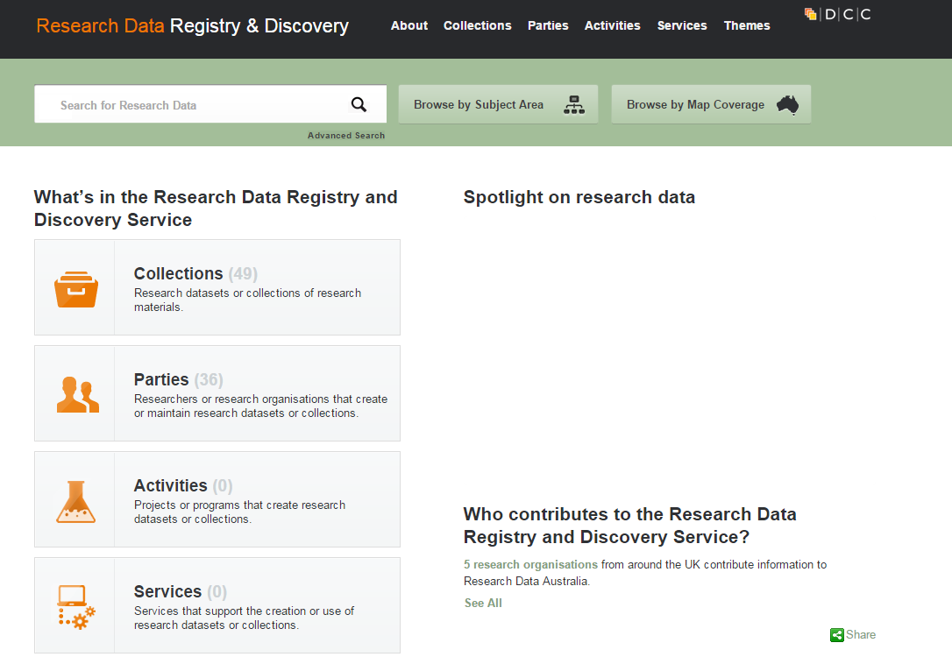
Data Catalogues
Funders
Institutional
National

Slide 16
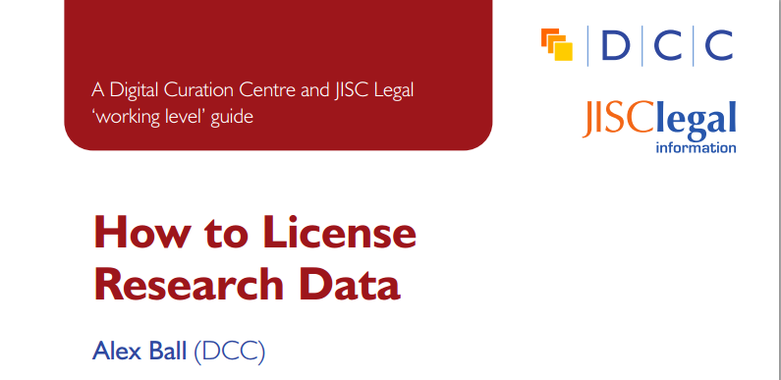
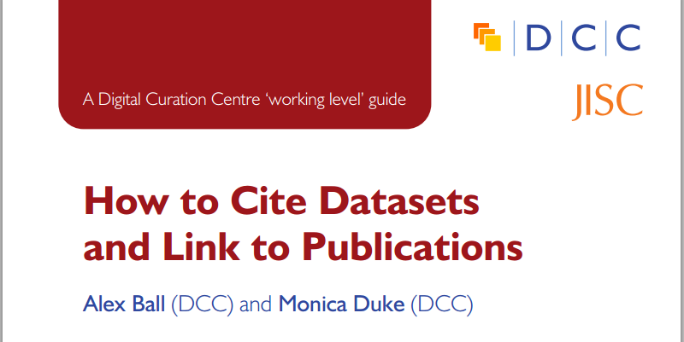
Tips for improving data reuse
www.dcc.ac.uk/resources/how-guides/license-research-data
http://www.dcc.ac.uk/resources/how-guides/cite-datasets
Notes:
License the data so it is clear how it can be reused
Make sure it’s clear how to cite the data

Slide 17
Data Management Planning
Integrating data management planning into grant lifecycle
Data Management Planning

Slide 18
What is a data management plan (DMP)?
What data will be created (format, types, volume...)
Standards and methodologies to be used (incl. metadata)
How ethics and Intellectual Property will be addressed
Plans for data sharing and access
Strategy for long-term preservation
Create
Preserve
Document
Share
Use
Store
Notes:
What is a Data Management Plan?
1-2 page summary.
Essentially, most funders just want evidence at the grant stage that data has been considered – how much will be generated? What formats will be used? Where will it be stored? Can it be shared?
It is important to stress to researchers at the pre-award stage that funders aren’t expecting something carved in stone . Projects often change quite radically from what is submitted at the proposal stage and this is ok. Researchers just need to be able to provide evidence that they have thought about the data they might be generating and how it will be managed and shared.
In terms of preservation, it is important to remember that not ALL data has to be retained. Selecting what data needs to be kept is something that only the researcher can do. Essentially, he/she will need to retain any data that underpins published findings to allow for validation of results. Additional data that is not required for validation purposes but is deemed to have longer-term value might also be worth keeping.
DMPs are often submitted as part of grant applications, but are useful whenever you’re creating data. Some HEIs are introducing policies that require DMPs for all research undertaken by staff – whether externally funded or not.

Slide 19


Data sharing plan
Covering:
Dataset
Standards
Metadata
Preservation
Data sharing
method
timescale
restrictions
agreements
Data Mgmt Plan
Covering:
Data
Data sharing
when?
where?
how?
restrictions?
Preservation
Resources
Data Mgmt Plan
Covering:
Data
Data collection
Management
Security
Data sharing
Responsibilities
Related policies
Admin details
Notes:
What do funders want to see? Some variations in what they want to see covered and in how much detail.

Slide 20
Why bother?
compliance
to help you manage your data
to provide guidelines for everyone to work to
to anticipate and avoid problems e.g. data loss, breaches
to avoid duplication
Notes:
Most will write a DMP to comply with funders requirements...but there are other benefits

Slide 21

https://dmponline.dcc.ac.uk
Notes:
Tools that can help.
The next few slides will explore issues that need to be considered across the grant lifecycle using the DCC’s DMP Online tool. This web-based tool helps researchers write Data Management and Sharing Plans
that meet specific funder’s requirements.

Slide 22
Data Management Planning
Pre-award phase
Data Management Planning

Slide 23
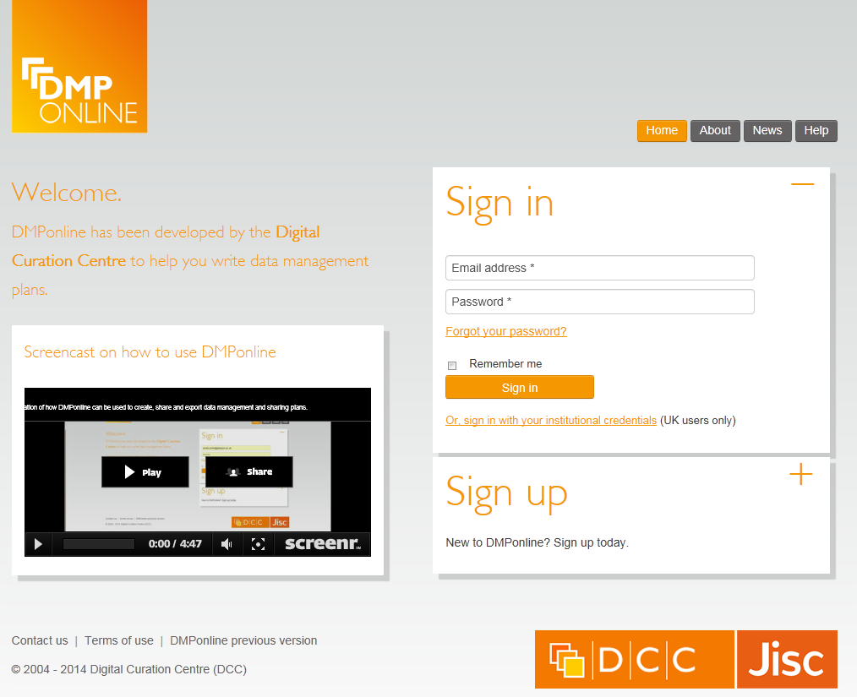
Sign up or sign in
Use your email and password to login
Or if you’re at a UK university, you can use your standard university login
Notes:
Writing a plan. Freely available tool that anyone can register to use.
Sign up with your email address, organisation and password.
Select ‘other organisation’ if yours is not listed.

Slide 24
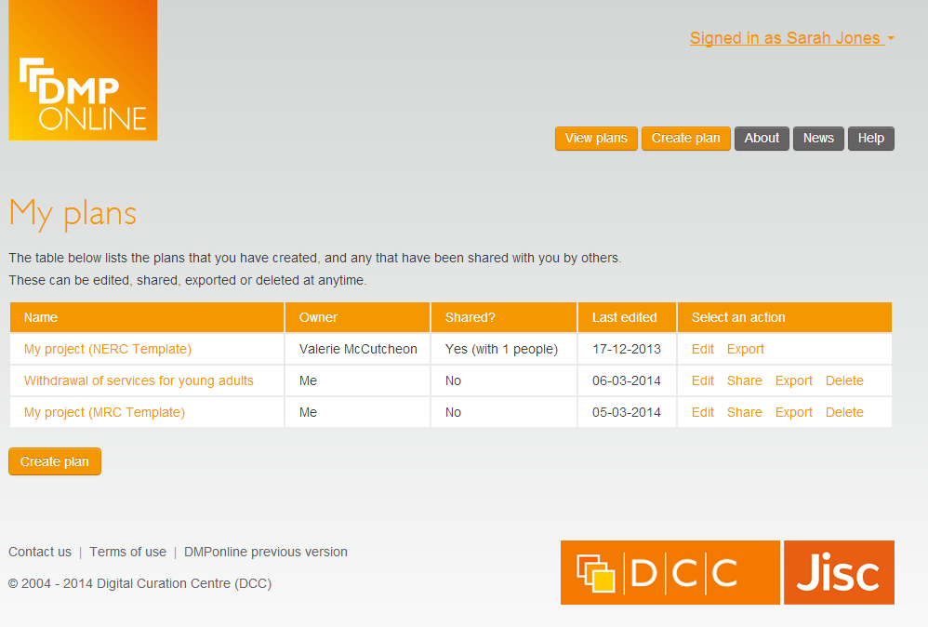
‘My plans’ page
Summary of the DMPs that you have created, or others have shared with you.
Note the varying permissions.
Notes:
You can start plans, save them and come back to them later. When you log in, you are taken to your ‘my plans’ page. Here, you’ll see all of the plans you’ve created. You’ll also see who owns the plan and if the plan has been shared.

Slide 25
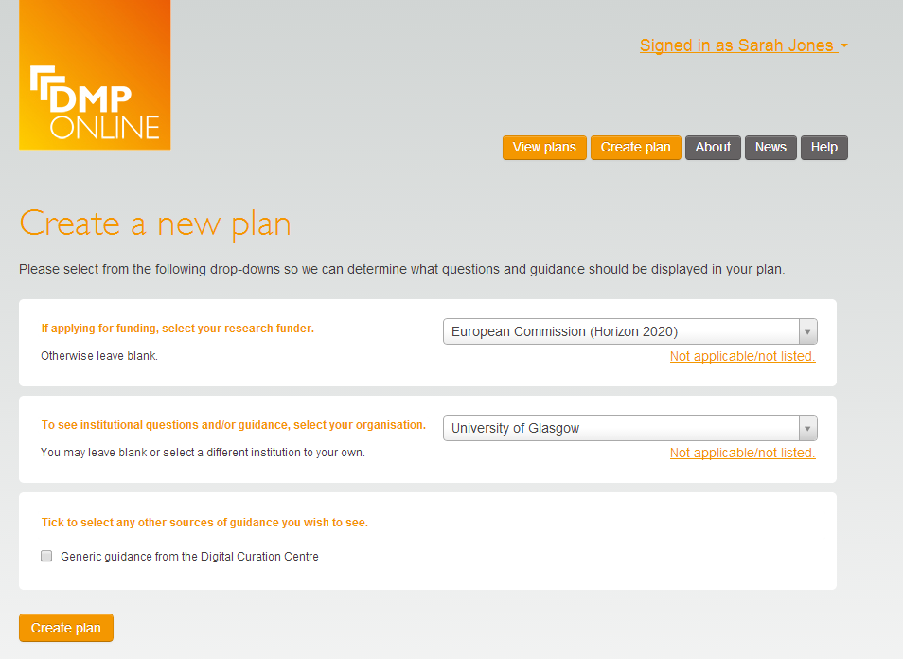
Creating a plan
Select funder (if any)
Select organisation for additional questions and guidance
Select other sources of guidance
Notes:
If researchers are required to produce a data management plan at the grant application stage, they can select a template in DMP Online that covers the specific questions the funder has relating to data management, sharing and access.
As many UK HEIs are moving towards compliance with EPSRC requirements, a number of universities are developing their own research data policies. Many HEIS policies require that a data management plan be produced for all new research being undertaken within the university. Some institutions’ polices include PhD students and unfunded research activity. Others are more geared towards funded research by academic staff. The DCC is collecting examples of explicit policies on research data and examples of existing policies amended to encompass research data. If you are looking to create your own policies, you are likely to find these examples useful.
http://www.dcc.ac.uk/resources/policy-and-legal/institutional-data-policies/uk-institutional-data-policies
DMP Online also allows universities to define and upload their own institutional templates so that any institutional policies and expectations can be clearly laid out.
What the grants team can ensure at the pre-award stage is that a grant identifier is recorded in the data management plan. This may be an automatically generated ID that is provided when new details are entered into the system.
As noted earlier, project names and objectives can change so recording a grant identifier will enable the data management plan to be linked as the project moves from pre-award through to in-award and post-award stages.

Slide 26






Use standard identifiers wherever you can
Researcher IDs
Dataset IDs
http://orcid.org/
https://www.datacite.org/
Grant IDs
Funder IDs
http://www.crossref.org/fundingdata/
Notes:
ORCID provides a persistent digital identifier that distinguishes you from every other researcher and, through integration in key research workflows such as manuscript and grant submission, supports automated linkages between you and your professional activities ensuring that your work is recognized.
CrossRef – identifiers for funders.
Grant agreement numbers from funders (e.g., European Commission)
Grant identifiers from institutional system (Agresso, PURE)
As outputs are produced, consider applying a Digital Object identifier (DoI) from DataCite.

Slide 27
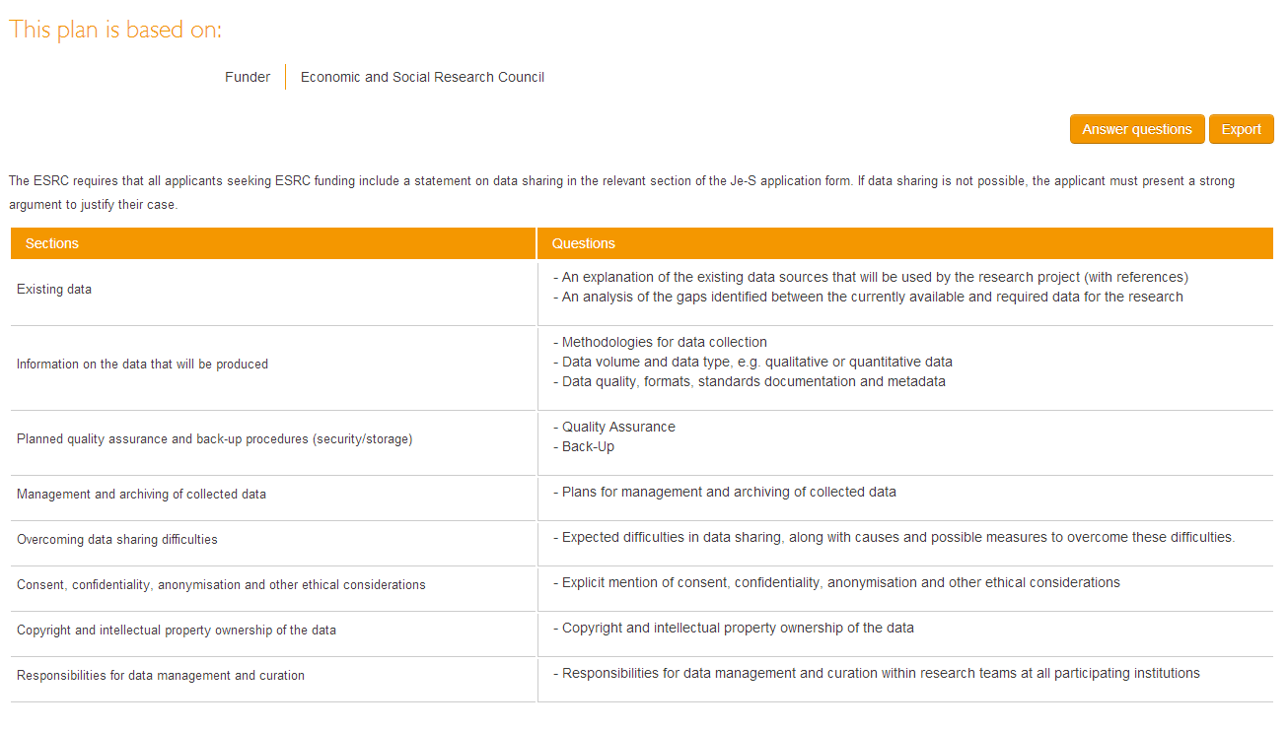
Plan details: summary
Summary of the sections and questions in your DMP
Notes:
Researchers can see a list of all the sections and questions they’ll have to answer for the funder they select. In this case, ESRC.

Slide 28
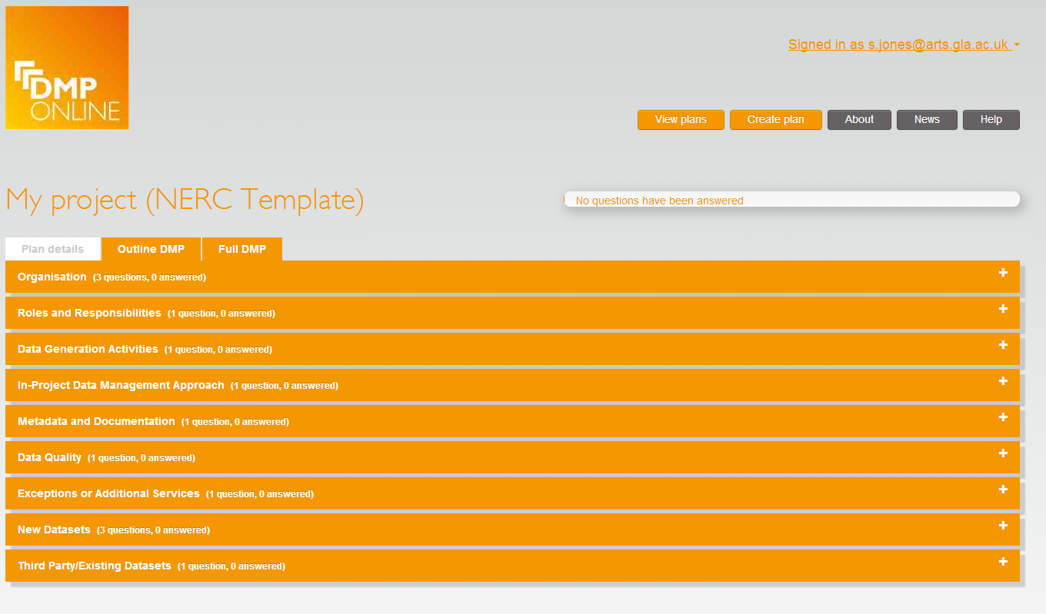
Overview of sections in a DMP
Enables multiple phases
Summary page with dropdown buttons to expand and answer each section
Notes:
Researchers can also see progress in terms of how many of the questions they’ve answered in each section. Much of the basic project information need to be provided by the researcher themselves. However, depending on how project approval processes are managed within your institution, it might be possible to duplicate this information from other application procedures (e.g., applying for ethics approval, raising a project approval form). This can help to ensure consistency across the project lifecycle.

Slide 29
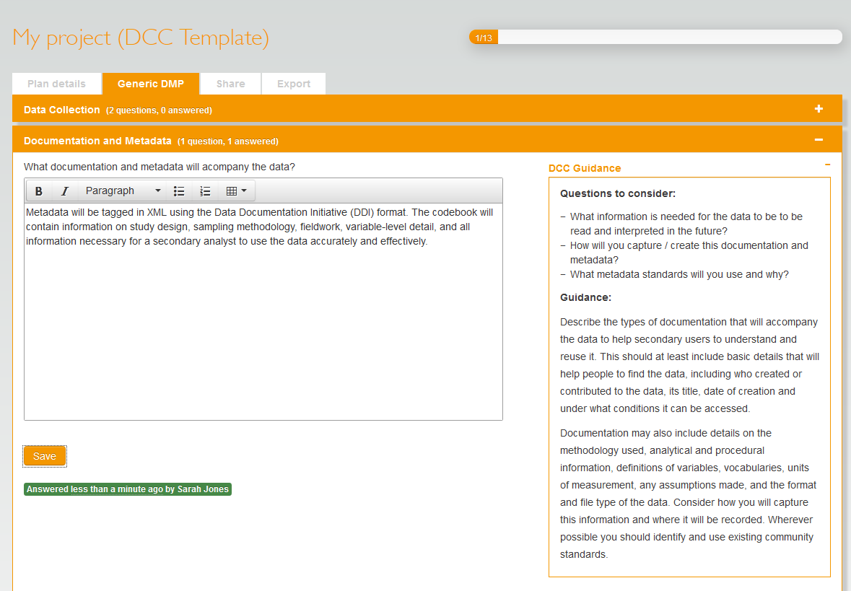
Answering questions
Notes who has answered the question and when
Progress bar updates how many questions remain
Notes:
Researchers need to provide the details on what data might be captured, in what quantities, and what formats might be used. As noted previously, estimates at this stage are ok. Funders don’t expect everything to be carved in stone at the application stage and are merely looking for evidence that some consideration has been given to the nature and scale of the data that might be produced within the project and how this will be managed and shared.
Researchers should contact local or central IT services for advice on short term and longer term storage requirements. It is important to get this started early enough to be able to identify any additional costs that may need to be factored into the grant application.
Researchers will need to think about how data will be backed-up if they plan to work outside the university system (i.e., remotely using laptops or personal devices).

Slide 30
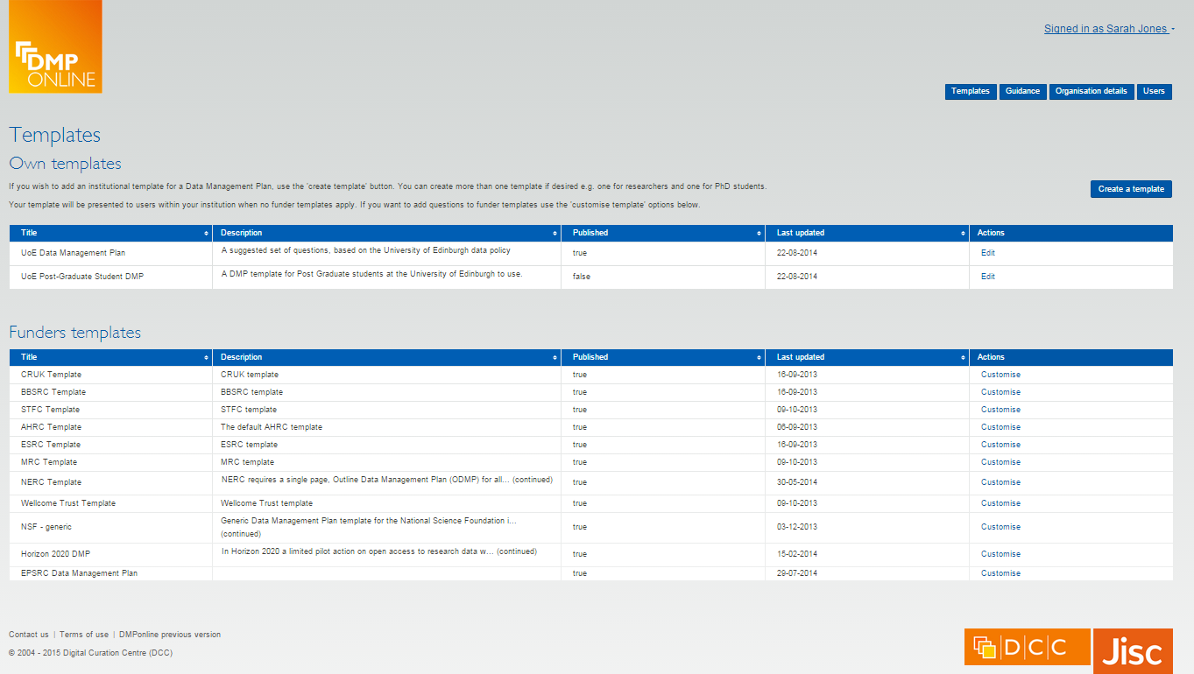
Admin interface for HEI guidance
Contact us to request admin access on dmponline@dcc.ac.uk
Notes:
Allows you to add your own templates/guidance and view users

Slide 31
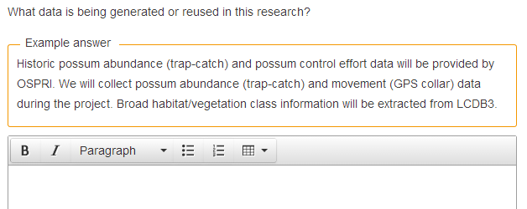
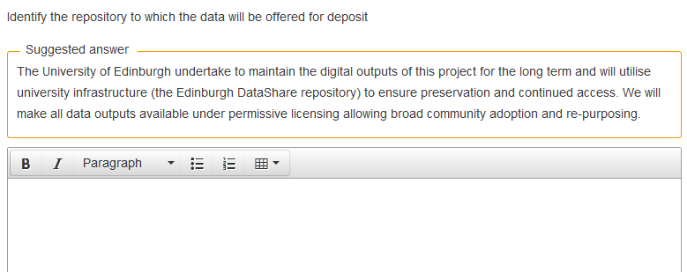
Provide examples and suggested answers

Slide 32
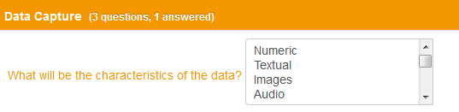
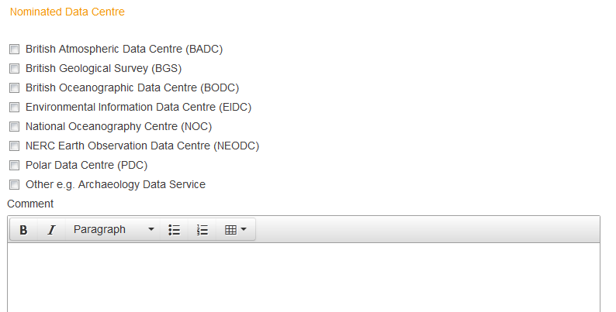
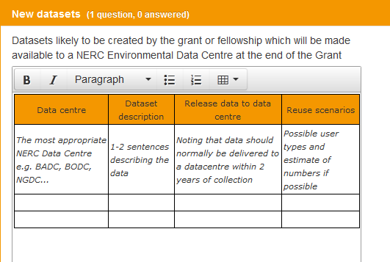
Dropdown options and default styles
Notes:
A strucutred approach can be particularly useful if you are planning to mine and analyse the information held within data management plans to inform further RDM infrastructure development.

Slide 33
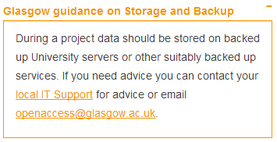
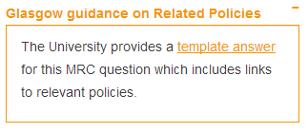
Organisational guidance
Guidance can be added by theme (to apply across the board) or can be written for specific questions
Themed guidance
Specific guidance
Guidance that pertains to MRC question 7 only
Guidance that is presented whenever researchers are asked about storage and backup

Slide 34
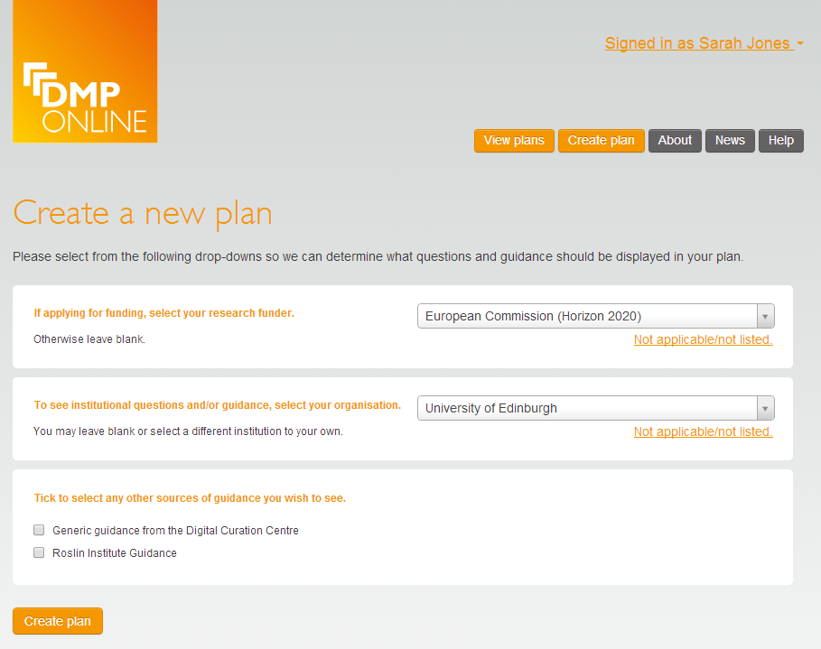
Guidance can be set at multiple levels
Options to have guidance at organisation and ‘unit’ level e.g. by discipline, group, department, institute…
Notes:
You may want to provide different templates for different audiences e.g. PhD students and research staff

Slide 35
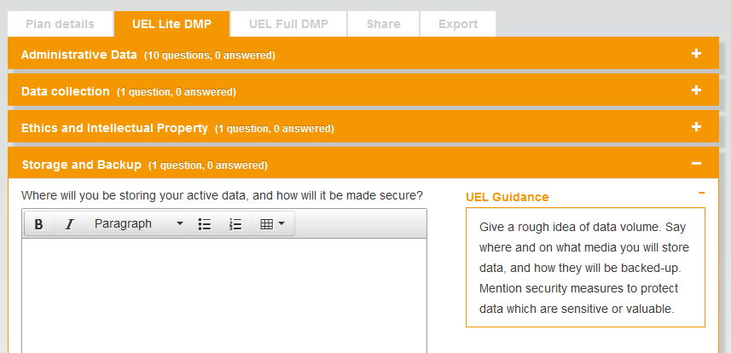
Local guidance is now presented to users
Notes:
Add your own template(s)
Add questions to other templates
Add custom guidance
Add dropdowns, examples, suggested answers...
Brand the tool (coming soon)

Slide 36
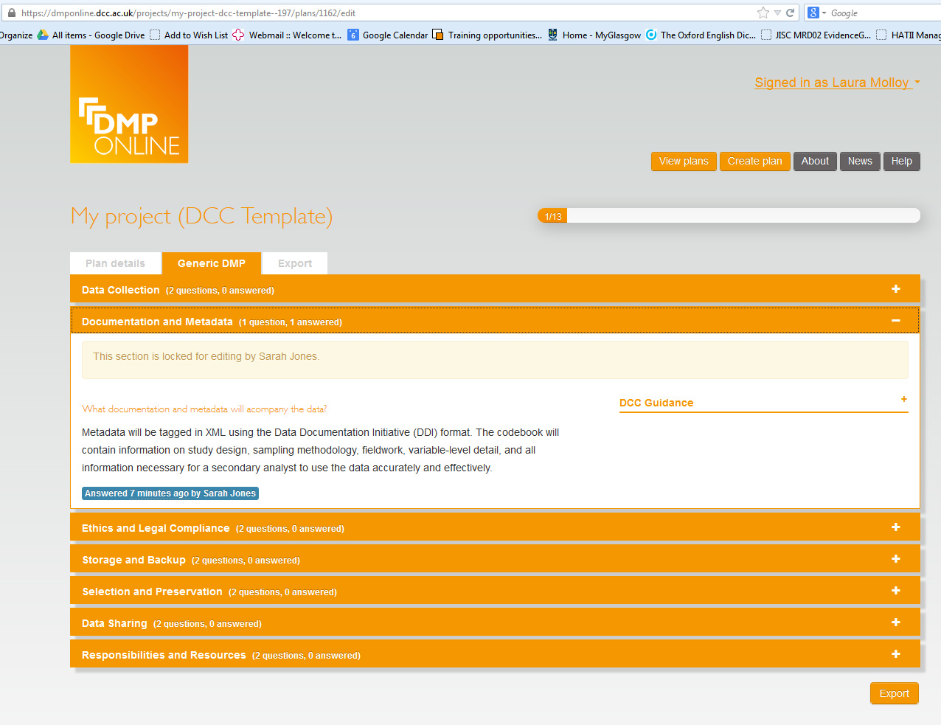
Co-writing DMPs
Sections are locked for editing when they’re being worked on by colleagues
Notes:
If there are institutional policies and practices that have to be followed, these should also be mentioned in this section. For example, if there is an institutional policy on research data management it could be cited in this section. Alternatively, there may be local working practices at the Research Group/School/College level that could be mentioned. These might be provided as boiler-plate text to assist researchers to complete the data management plan.
Many HEIs are developing institutional specific guidance to help researchers to complete their DMPs.

Slide 37
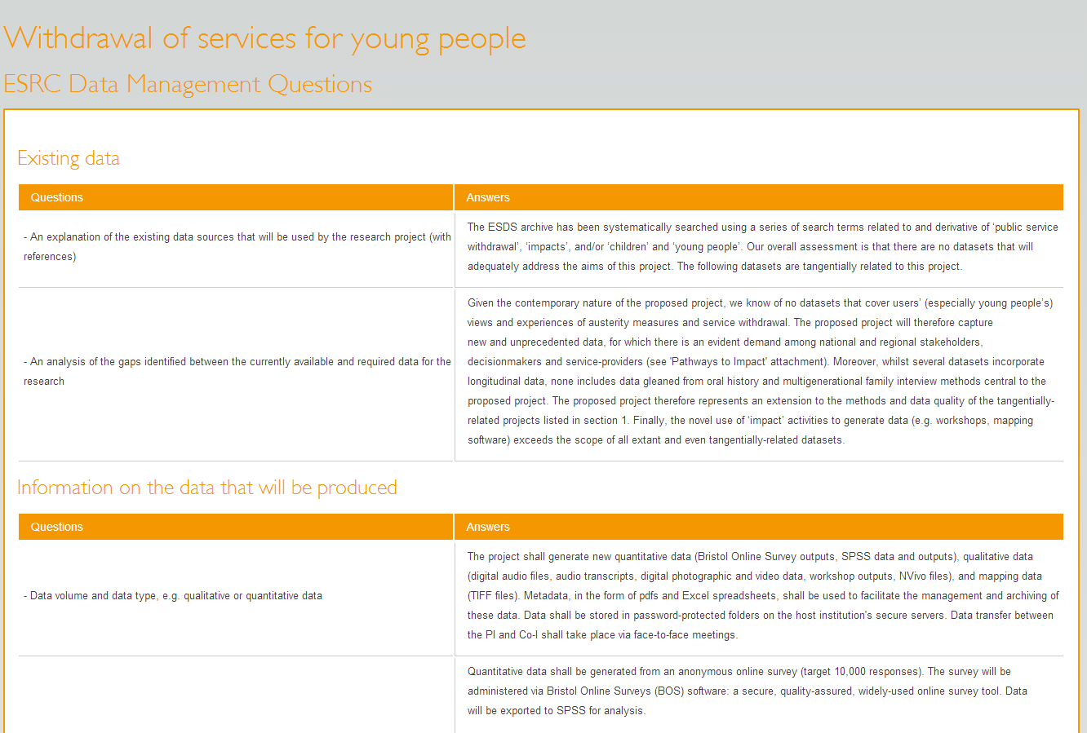
Exporting DMPs
Can export as plain text, PDF, html...
Notes:
In some institutions, the data management plan may require sing-off by any/all of the contributors. If so, this will also increase the burden on Research Office staff and the amount of lead in time needed to complete the grant application. It may be the case that the Research Office simply checks to see that there is a data management plan appended to the application to ensure that the application isn’t rejected rather than anything more onerous. These sots of decisions will need to be made within your organisation.
Research office staff may want to consider maintaining a copy of the pre-award version of the data management plan as a component of the application record. If you do decide to keep a copy of the pre-award data management plan as part of the grant application record, you may opt to retain the plan as a PDF. DMP online allows you to export a clearly marked copy of the plan in a variety of formats and includes a time stamp for context.
As noted earlier projects can change. Once funding has been secured an updated version of the data management plan should be produced. DMP Online allows the researcher to move from a pre-award version of the data management plan to an in-award version. This version should be updated as needed and is not meant to be a static document. Again, it is a good idea to record the grant identifier with all versions of the data management plan for consistency.
It can be helpful to have real examples of completed data management plans within the Research Group/School/College to help other researchers. It might be an idea to suggest that any institutional data management plan templates developed for use within your organisation include a tick box that allows researchers to state whether they are happy to make their data management plan visible to colleagues.

Slide 38
Consider any costs that need to be included in grant application
In-project costs only
Post-project costs could be direct (e.g. charges levied by data centres) but typically fall into indirects
Justifications of Resources should, where possible, separate out RDM cost elements
Notes:
In-project costs should be included in the direct costs for a project
Post-project costs could be direct (e.g. charges levied by data centres) but typically fall into indirects as universities should provide infrastructure to support RDM
The Justifications of Resources should, where possible, separate out the following RDM cost elements:
cost of collecting data
the cost of curating data
the cost of analysing data
the cost of preservation and sharing

Slide 39
Tips for researchers writing DMPs
Encourage researchers to start early - don’t wait until the last minute to develop plan!
Encourage researchers not to write the plan in isolation – they seek advice from colleagues, ethics, IT, library, DP/FoI...
Researchers should be realistic - base plans on available skills & support
The plan will - and should - change over life of project

Slide 40
Data Management Planning
In-award phase
Data Management Planning

Slide 41
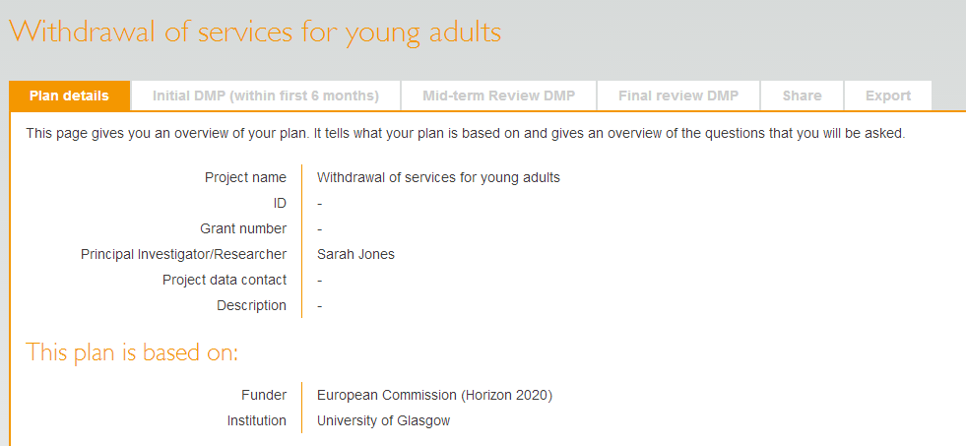
And templates can have multiple phases
Phases
This encourages researchers to actively update the Data Management Plan throughout the project
Notes:
Research Office staff may see dozens of proposals coming through each month in addition to the ongoing efforts to close off projects coming to an end each month. With already over-stretched workloads, it is important to make sure that any institutional processes are adequately resourced. As it is early days for most HEIs in developing and sustaining research data management services and systems, it might be good to keep a log of the number of hours you spend each month on this aspect of the application process. This may be helpful if additional staff resources are required to meet demand.
It is unrealistic to expect that Research Office staff will be able to contribute towards monitoring adherence to the plan. This needs to happen within the research project team. However, the Research Office might aim to include some reminders in their grants management systems so that automatic reminders are sent out to PIs to make sure that data are registered and/or deposited as stated in the pre-award plan. The automatic notifications may also ask for an updated version of the plan to be sent for inclusion with project documents at the wrap-up stage.
Checking in occasionally may make the process less burdensome once the project comes to an end.

Slide 42
Data Management Planning
Post-award phase
Data Management Planning

Slide 43
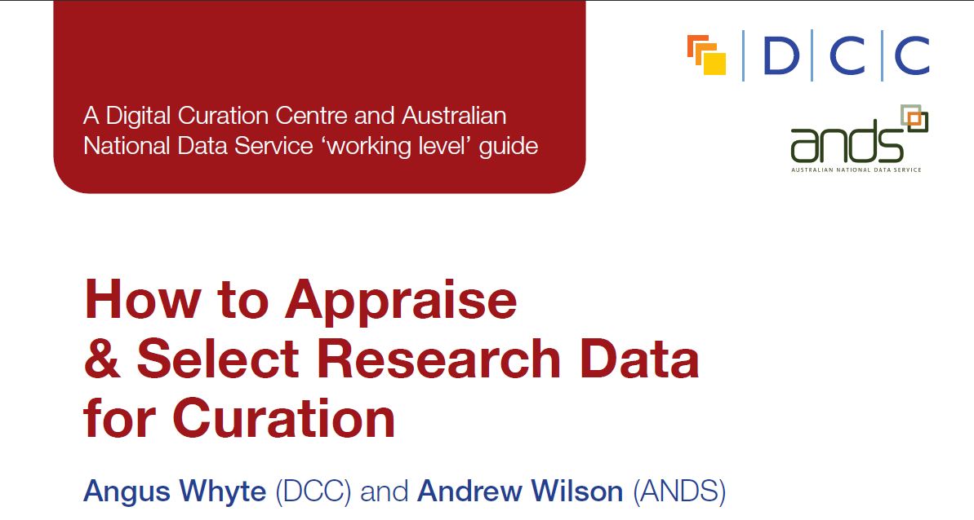
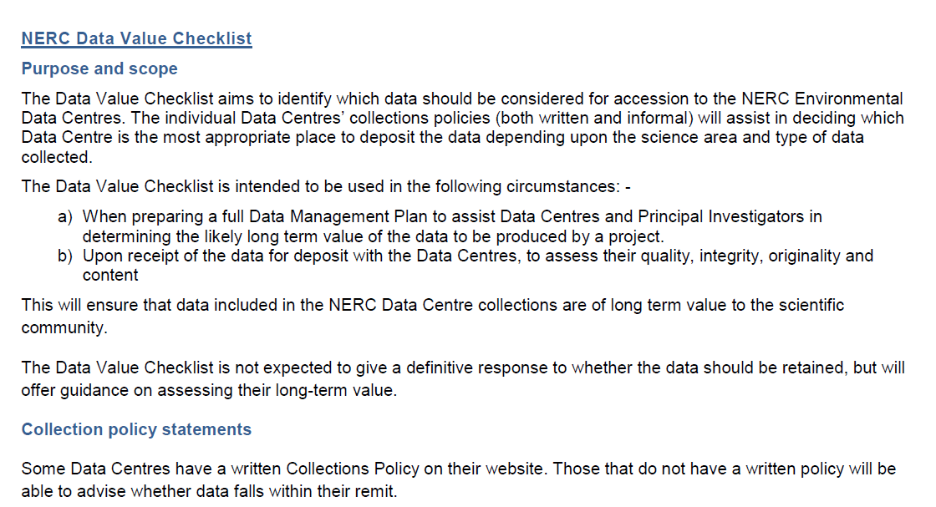
Guidance on selection and appraisal
http://www.dcc.ac.uk/resources/how-guides
http://www.nerc.ac.uk/research/sites/data/documents/data-value-checklist.pdf
Notes:
Researchers may find the NERC data value checklist useful at the pre-award stage. The checklist helps researchers to identify any potential outputs that may have longer term value and should be retained. The checklist is also used to assess quality, integrity and originality of the data at the point of deposit into a data centre once the project has been completed.
Once the project has been completed, the DCC How-to select and appraise research data might be useful in identifying data that warrants longer-term retention.

Slide 44
Exporting DMPs
Can export as plain text, PDF, html...
Notes:
Once the project comes to an end, a post-award version of the data management plan can be saved to record outputs and actions that need to take place. It might be a good idea to amend automatic notifications that are send out by the grant system to notify PIs that the project is coming to an end to include a few reminders about registering and/or depositing data outputs into institutional or subject based repositories. Perhaps include a reminder about any Open Access publication requirements at this stage as well. You may want to suggest that copies of the post-award data management plan be sent to the repository and another to the grants team for inclusion with other project wrap-up documents.

Slide 45
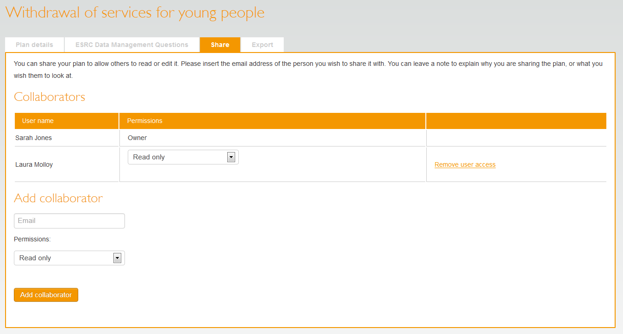
Sharing plans
Allow colleagues to read-only, read-write, or become co-owners

Slide 46
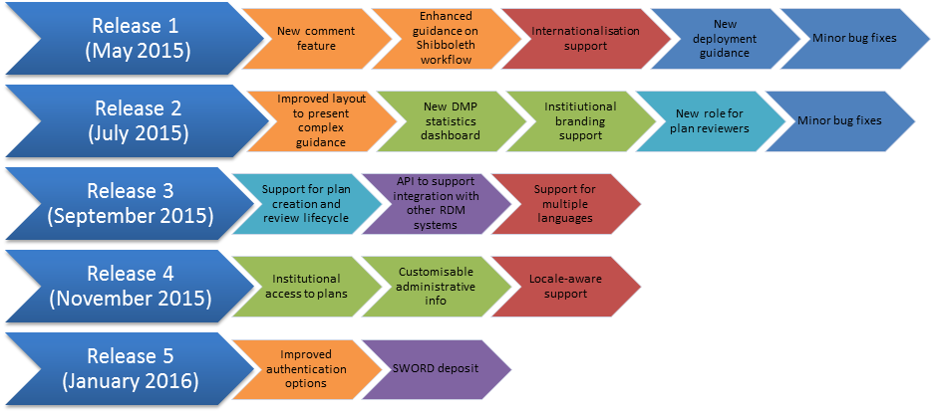
Roadmap for 2015
Notes:
Lifecycle:
Indicate different phases and versions of a plan
Flexible support for different institutional processes
When to provide institutional access to plans
Add review options
API for systems integration:
Determine the appropriate level of API for the community
Enable institutions to generate stats and mine content
Integrate with other university systems
Harvest core metadata from DMPonline
Export DMPs to collate a library of plans
Institutional enhancements:
Institutional branding
Customisable administrative data
Trigger alerts for event monitoring
Create a new template based on an existing one

Slide 47
DMPonline user group
Aims to make it easier for the community to feed in ideas and direct the development of DMPonline
We’ll post plans for consultation and periodically hold webinars or face-to-face meetings to gather input on specific aspects of implementation
Hope to get participants covering all roles e.g. researchers, RDM co-ordinators, administrators, developers, funders...
Subscribe to the user group listserv at:
www.jiscmail.ac.uk/DMPONLINE-USER-GROUP

Slide 48
Summary
Understand current workflows and where data management planning might be integrated with other processes (e.g., ethics approval).
Will you require a copy of the DMP for your records?
Consider how you might use the data contained within DMPs to help with forecasting.
Consider customising your own template
Notes:
But also be aware that integrating systems and processes can be time and resource consuming.
If you want a copy, how will you ensure that one is provided?
DMPs can provide useful info about storage requirements and other aspects of RDM. Pre-award versions are estimates but you’ll need to have a post award to be able to know if what was planned was accurate. How will this happen?
Consider customising your own DMP template within DMPonline. Imply register for an admin account. Think about the sorts of information you might want to be able to report on and think about how you might structure the DMP to best enable this. (e.g., less free text, more structured options presented to researchers).

Slide 49
Thanks – any questions?
DMP guidance, tools and resources:
www.dcc.ac.uk/resources/data-management-plans
Follow us on twitter:
@digitalcuration and #DMPonline
Notes:
Hopefully you’ve got a better idea of what a data management plan needs to include now and who might need to be involved in filling one in correctly.
Researchers need to know that the research office staff are not responsible for completing data management plans or for policing adherence to the plans during the in-award and post –award phases. This is the responsibility of the researchers on the project.
Research office staff might, however, need to make sure that researchers are aware of funders’ expectations and be able to point them to people who can help them to produce a realistically implementable plan.
The Digital Curation Centre has pulled together a lot of guidance and support and we encourage you to make use of these and to feed back any additional resources that may be needed.

